Slide 1
District Cloud Faxing Transition
School District of Holmen
Dave Truchan, Software Support Specialist
Notes:
Thanks for staying for the second half of the presentation, if time allows I will open the admin web interface after the presentation

Slide 2
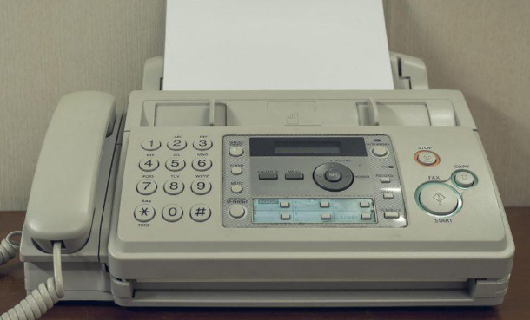
Analog, (POTS) fax lines at 10 locations
Elevators and faxes sharing analog line via line sharing devices
Dedicated fax lines
Fax machines on location - copiers with internal fax modules
Notes:
We went from 10 locations down to 8, eliminating lines at our TMT and Alternative learning site. These areas can still send faxes via email the just will not receive them at a dedicated number.

Slide 3
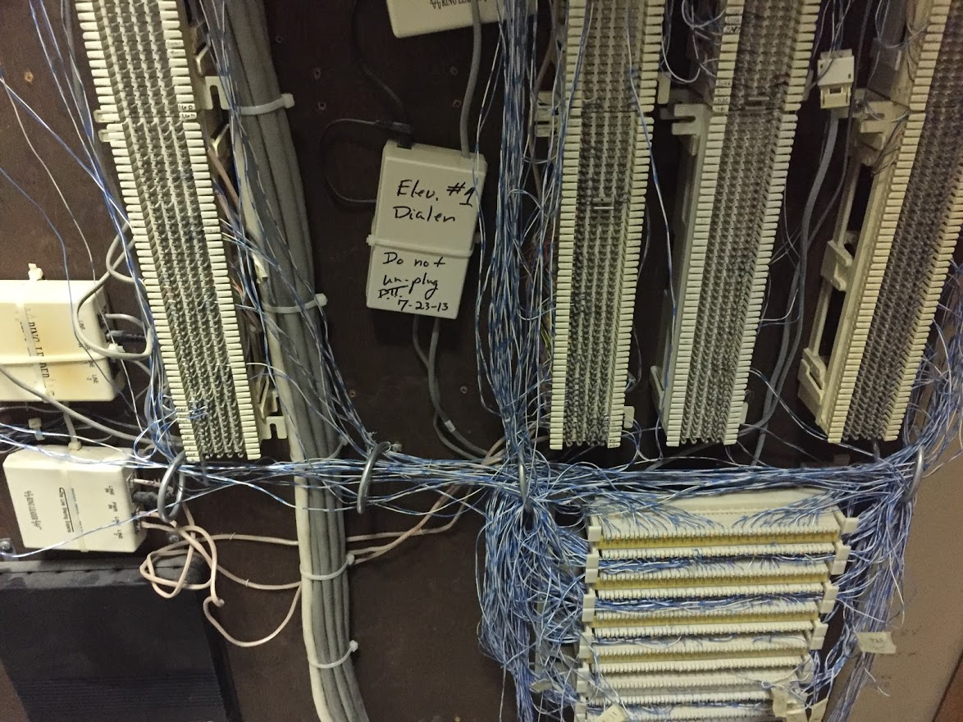

Slide 4
Supporting analog lines on premise
Outages
Time spent resolving issues
Work with telecom vendor to resolve outages
Work is billable if issue is onsite
Notes:
Reasons for transitioning to online faxing

Slide 5
Supporting analog lines on premise.
Construction
Line sharing device failure
Squirrel/rodents
Weather
Hardware failure/fax machine

Slide 6
School District of Holmen eGold Cloud fax plan cost
Cloud Fax: E cloud Fax subscription
500 pages per month $49.99
Each additional line 0.50 month
Overage (0.10 per page)
Lines charge 8 lines @ 0.50 $4.00
One time porting fee $20.00 per line

Slide 7
Cost comparison
POTS Lines
10 fax lines - at $35 month = $350
eGold fax
Cloud Fax: E cloud Fax subscription
Oct. - Nov. 500 pages per month $49.99
Plan Overage (Sept. - Oct.) $66.00
Lines charge 8 lines @ 0.50 $4.00
Total $119.99
Aug - Sept 2019 with overages $229.99
Sept - Nov 2019 with overages $119.99
Notes:
Cost comparison, active times are higher inactive times are lower. POTS line cost are higher than listed

Slide 8
Implementation
Choosing a vendor
eGold fax service
Porting numbers
Submit LOA form,(Letter of Authorization)
Submit phone bill
Send information regarding cutover and faxing instructions to key staff via email
Notified administrative assistants at each building
Notes:
Nuts and bolts of the transition.

Slide 9
Porting process:
Send email to vendor with port number with LOA and most recent phone bill
Get port date from vendor Notify building administrative assistants of date
Notification will be sent upon port completion

Slide 10
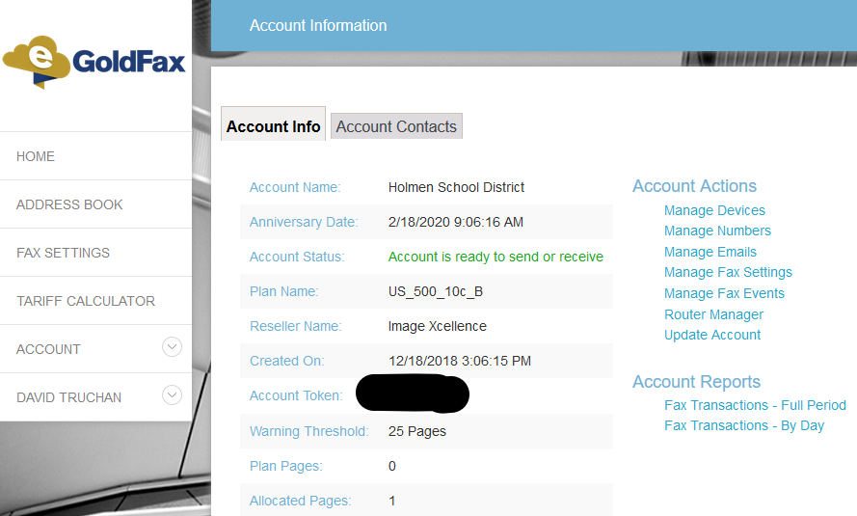
eGold web interface
Notes:
Anniversary Date: 18th counts reset

Slide 11
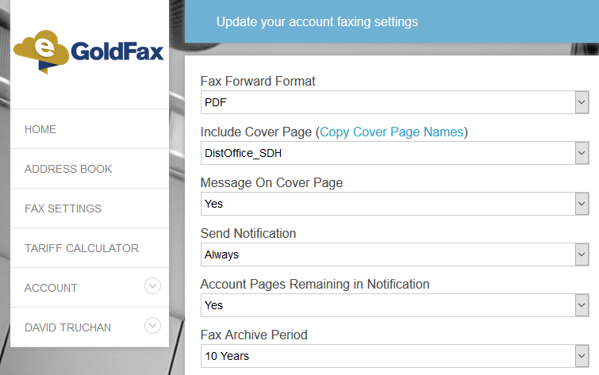
Default settings
Actions>Manage Fax settings

Slide 12
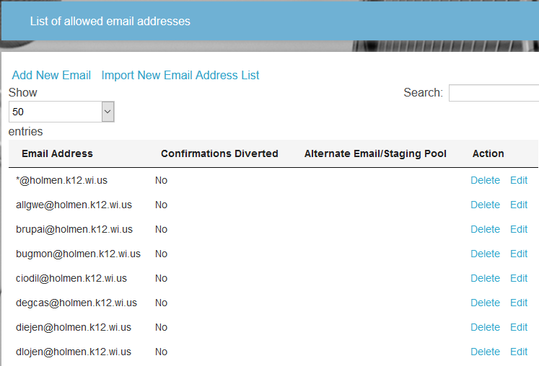
Email settings
Actions>Manage Emails

Slide 13
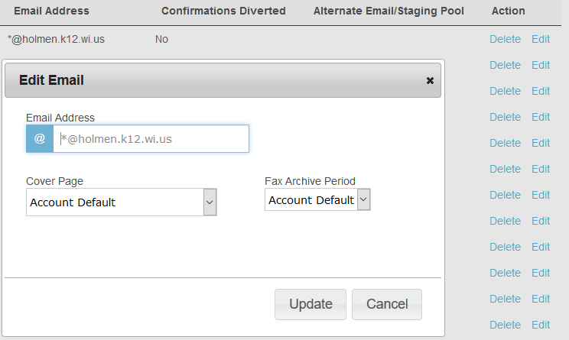
Edit email address
Cover Page
Archive Period
Students can not fax
Notes:
Uses district default cover page with district office fax number

Slide 14
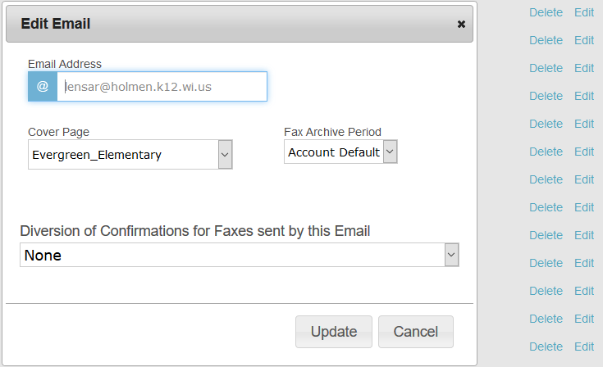
Example of building fax recipient that sends faxes with custom cover page

Slide 15
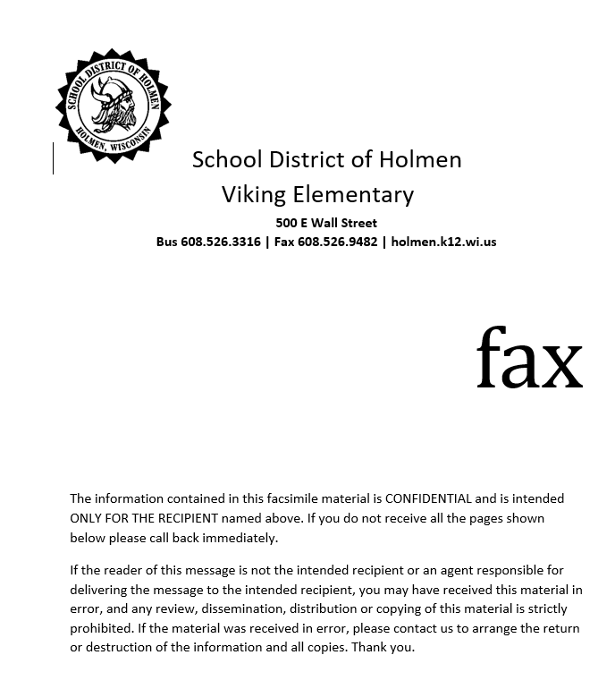
Create your own Fax cover
Word document, black and white can include text from original email
Notes:
Cover page example

Slide 16
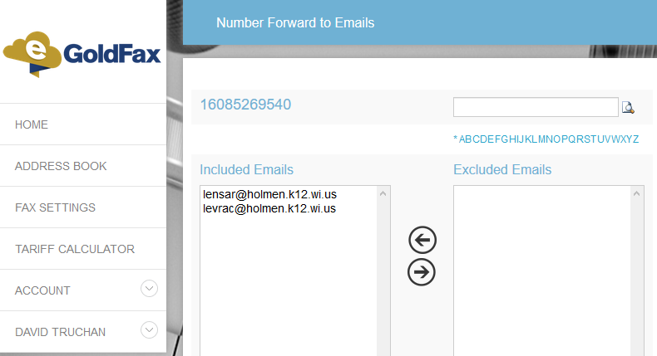
Example of building fax number assigned to recipient
Fax number

Slide 17
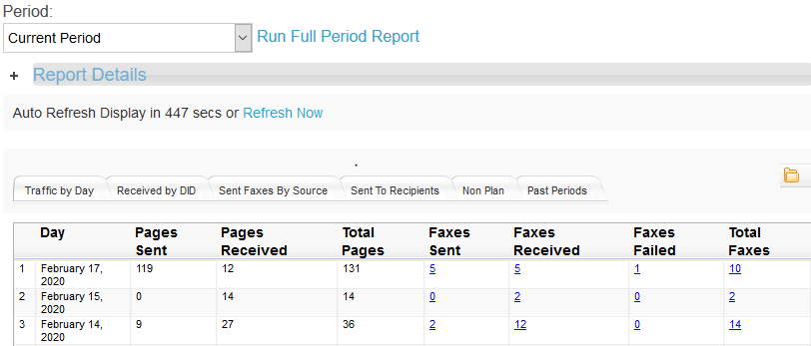
Account Reports
Fax Transactions - Full Period
Fax Transactions - By Day

Slide 18
Pros
Senders receive a confirmation/failure email for all faxes
No chasing copper lines in the spring and fall
Reliable
Cons
Sending/receiving end fax issues get blamed on eGold system
Contacted the sender and asked them to fix the fax machine
Recieving can timeout just like with an in house fax machine
Looking back, we did not have a lot of information going into the project. Mid stream we found that you could add fax information into the cover page and the porting process was a little slow at first even though we had ported numbers for a phone project in the past.

Slide 19
Final questions? Thank you for attending!

